Slide 1

Micro credit defaulter
Lahari S.K
Intern-Data Science at Flip Robo Technologies

Slide 2
Content
Problem Defination
RoadMap
Data Validation
Correlation
Pre-processing
Feature Selection
Outliers
Splitting data
Standard Scaling
Model Building

Slide 3
Problem Definition
A Microfinance Institution is an organization that offers financial services to low income populations. The MFI mainly targets the low income families which have one or two sources of income due to which they will not be eligible to take loans from banks.
Microfinance Institutions serves several clients one such client is telecom Industry. They are fixed wireless telecommunication network provider.
Telecom industry are collaborating with MFI to provide micro-credit on mobile balances to be paid back in 5 days. The consumer is assumed defaulter if he fails to pay within the deadline and non-defaulter if he succeeds paying within the time.
For a loan amount of 5 payback amount should be 6rs(Indonesian Rupiah),while for amount of 12 payback amount should be 12.

Slide 4
Road Map
Importing the data
Data Validation
Data Exploration
Feature Engineering
Model Buiding
Data PreProcessing
Transformation/Scaling
Score Caluculation

Slide 5
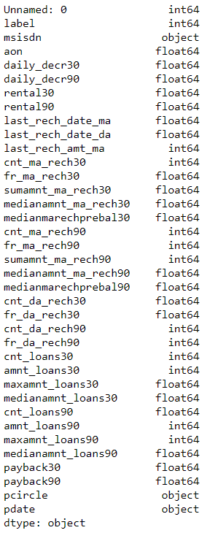
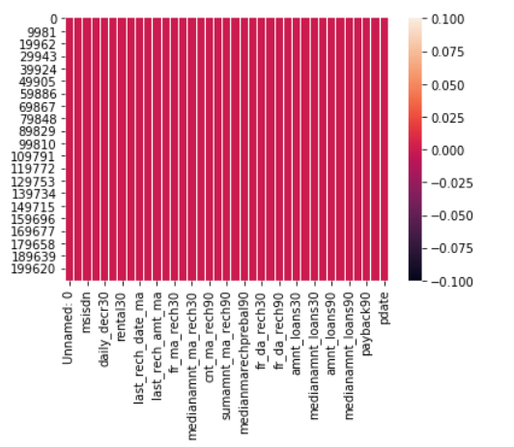
Data Validation
The data set is a comma separated value file. The dataset contains 37 columns and 2,0,9593 rows.
It contains both object and numerical data types.
When checked for null values there were no null values found.

Slide 6
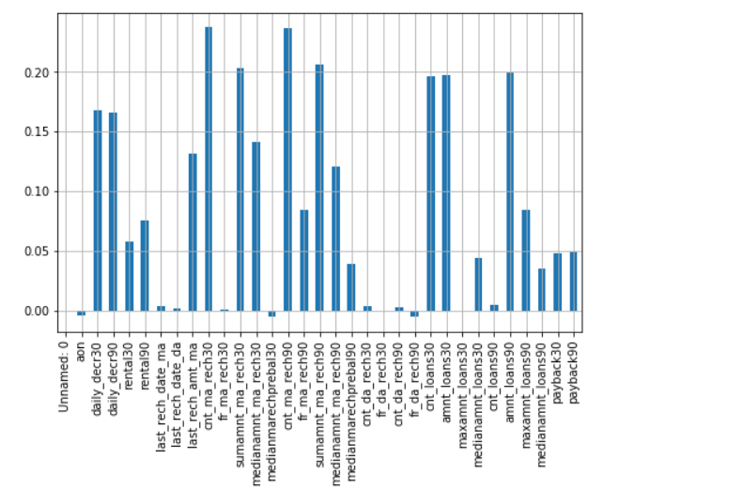
Correlation
Lets see the correlation between our target variable and other feature variables.
So we can observe that the highest
correlation attained is 0.24 with respect to
target variable.
It can also be noticed that aon,median
marechprebal30,fr_da_rech90 are
negatively correlated so that they can be
dropped.

Slide 7
Preprocessing
As a part of pre-processing the date has been split into year, month and day. Since year is same for all the given dates it is dropped since it is not having any impact.
In order to convert the categorical variables into numerical ones label encoder is implemented.
I have also created a copy of the data set in order to carry out the feature engineering.

Slide 8
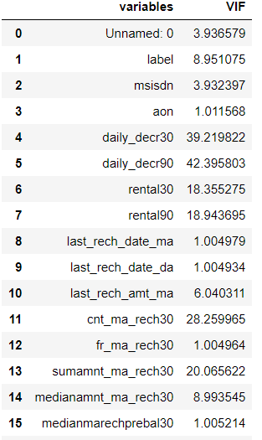
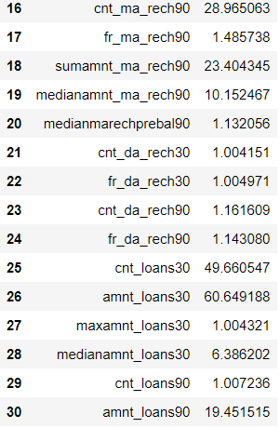
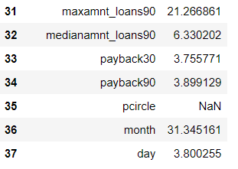
Feature Selection
As a part of feature selection variance_inflation_factor has been implemented.
Variance Inflation Factor is used to determine the correlation between the independent variables.
The columns having greater vif values of more than 5 are kept and remaining are dropped keeping in mind they have high collinearity and the strength.
After evaluating VIF 17 columns have been dropped due to low collinearity.

Slide 9
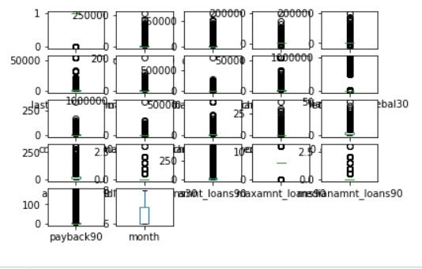
Outliers
From the boxplot we can observe that the outliers are present in all the features except month and label.
Z scores are used to remove outliers.
Zscores of data points having more than the
threshold 3 is considered as outliers and have
been removed. The shape of the data set after
removal of outliers is (174154, 21).

Slide 10
Splitting the data
The data set is now split into x and y .
x and y contains features are as follows
x=[‘daily_decr30’,’daily_decr90’,’rental30’,’rental9’,’last_rech_amt_ma,’
‘cnt_ma_rech30’,’sumamnt_ma_rech30’,’medianamnt_ma_rech30’,
‘medianmarechprebal30’,’cnt_ma_rech90’, ‘sumamnt_ma_rech90’,
‘medianamnt_ma_rech90’,’cnt_da_rech90’,’cnt_loans30’,
‘amnt_ma_rech30’,’mediansamnt_loan30’,’amnt_loans90’,
‘maxamnt_loans90’,’medianamnt_loans90’,’payback90’]
y=[“label”]

Slide 11
Standard scaling
Standard scalar is used and applied on the x.
It transforms the data in such a manner that it has mean as 0 and standard deviation as 1. It standardizes the data. It arranges the data in a standard normal distribution.

Slide 12
Model building
The algorithms used for building the model are as follows
Logistic Regression
Gaussian NB:
KNeighbour Classifier
SVC
Decision Tree Classifier
The ensemble techniques used are as follows
RandomForest Classifier
AdaBoostClassifier
GradientBoosting Classifier
Bagging Classifier
ExtraTree Classifier

Slide 13
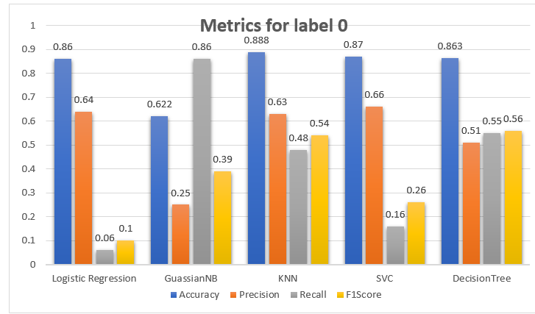
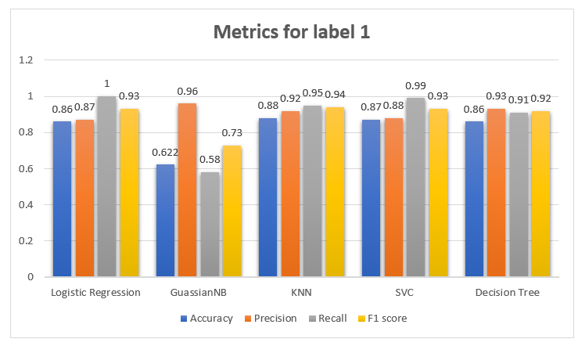
Metric’s scores
Score of the algorithms

Slide 14
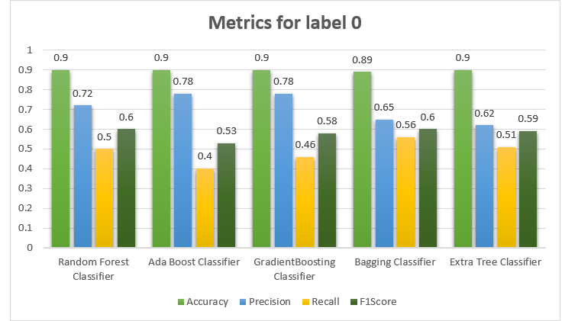
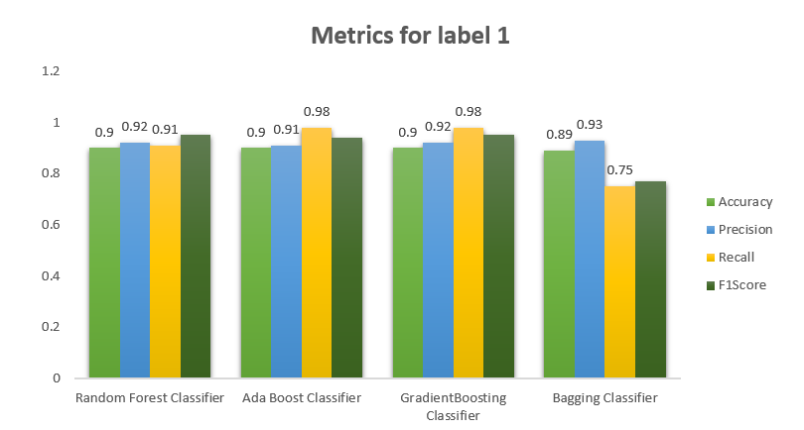
Metric’s Scores
Score of ensemble techniques

Slide 15
Suitable metrics to evaluate
1.Accuracy: When we have imbalanced data we cannot really rely on just the accuracy scores. Accuracy should be used when the data set is nearly balanced ,definitely not in our case.
2.Precision: Precisions tells us what proportion of customers we identified as defaulters/non-defaulters are really defaulters/non-defaulters respectively.
So out of 100 non-defaulters our model can identify only 63 as non-defaulters.
Precision is about being precise. So even if we managed to capture only one defaulter, and we captured it correctly, then we are 100% precise.
3.Recall/Sensitivity: Recall is not so much about capturing cases correctly but more about capturing all non-defaulter with the answer as “non-defaulter”. So if we simply always say every non-defaulter as “non-defaulter”, we have 100% recall.
4.F1 Score: The F-score is a way of combining the precision and recall of the model, and it is defined as the harmonic mean of the model's precision and recall.

Slide 16
So here in our case we should try to increase our true positive and true negative and reduce false positive and false negative.
As per the metric scores lets consider bagging classifier as best model
I have carried out two methods to increase TP and TN that are
1.Oversampling
2.ADAYSN

Slide 17
Bagging classifier
1.Over Sampling
Over sampling is a technique of increasing the data points frequently on the same data so that the minority class data points are increased.
Before the over sampling the count of minority class was 18795 and after over sampling the count of minority class is 93636.Its increased 5% times.
2.ADASYN(Adaptive Synthetic Sampling Method)
ADASYN (Adaptive Synthetic) is an algorithm that generates synthetic data, and its greatest advantages are not copying the same minority data, and generating more data for “harder to learn” examples.
Before the over sampling the count of minority class was 18795 and after over sampling the count of minority class is 93636.Its increased 5% times.

Slide 18
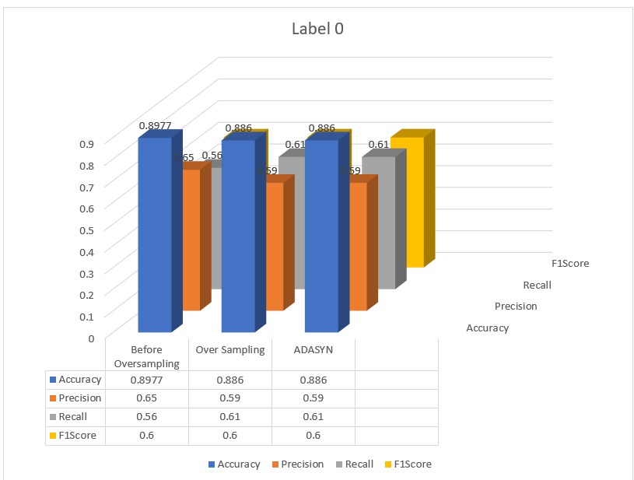
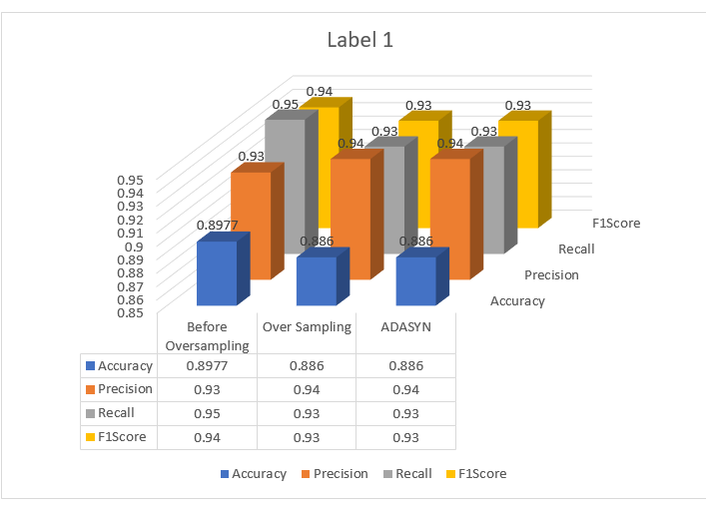

Slide 19
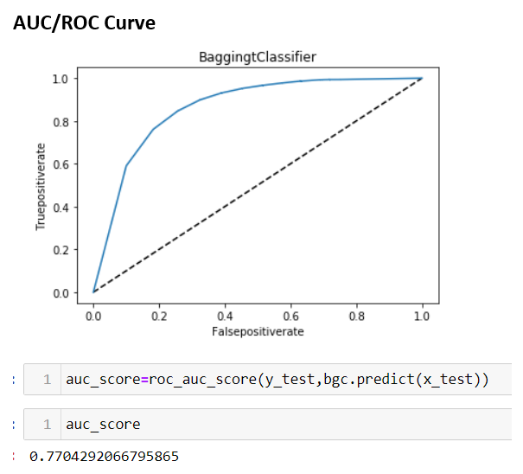
Among ADASYN and over sampling ,ADASYN gives better results.AUC_ROC Curve is
Given below
So 0.77 is a good value which means our model can diffrentiate between defaulter and non defaulters correctly by 77%.

Slide 20
Thank you

